Slide 1
Decrypting Affine Diagraph Ciphers
By: Tucker Yazdani
Supervised by: Dr. Mark Faucette

Slide 2
Introduction
In this presentation we will discuss how to decrypt affine diagraph ciphers using algorithm development, number theory, and linear algebra. In this project I was given a code 674 characters long to decrypt. I was also given three essentials to decrypt this code. First, I was told that the first tens letters of the code decrypted reads “ARCHIMEDES”. Second, I was told this code was encrypted with an affine diagraph cipher. Lastly, I was given a professor of mathematics as a supervisor.

Slide 3
Cryptography
To first explain the affine diagraph cipher and how it was decoded, we need to first understand cryptography at a basic level. Cryptography is the idea of encoding messages securely without having someone unintended being able to decode the message themselves. Cryptography in mathematics usually involves taking a letter and mapping it onto a number. For example naturally A=1,B=2,…,Z=26. After a letter has been mapped onto its corresponding number, we then preform some strategy to decrypt the message so that no one else besides the intended party can access it. There are many ways to decrypt messages, but in this presentation, we will focus affine diagraph cipher. To explain this more complicated cipher, we must first understand how ciphers work in detail.

Slide 4
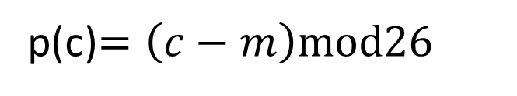
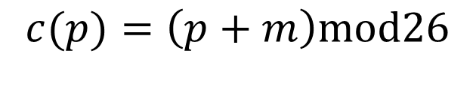
The Shift Index
The shift index only takes a letter and assigns it a number, and then maps it to a different letter based on the step size. This is one of the simplest ideas in cryptography and is also the easiest to crack. The issue with this is the code is easily cracked by counting the frequency of the letters, and then finding the difference between the two most common letters and there's the shift index. Now the entire message can easily be deciphered.
Encryption Equation
Decryption Equation
$$c(p)=\left(p+m\right)mod26$$
p(c)$=\left(c−m\right)mod26$

Slide 5

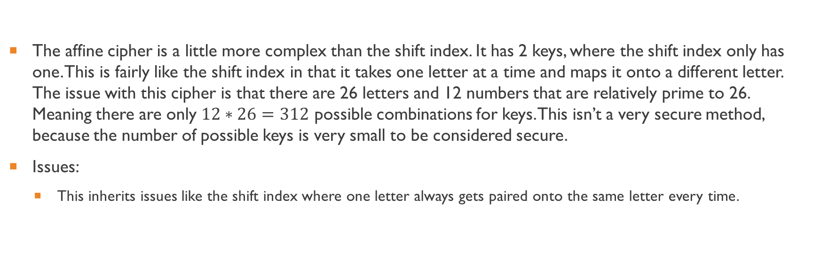

Affine Cipher
The affine cipher is a little more complex than the shift index. It has 2 keys, where the shift index only has one. This is fairly like the shift index in that it takes one letter at a time and maps it onto a different letter. The issue with this cipher is that there are 26 letters and 12 numbers that are relatively prime to 26. Meaning there are only $12∗26=312$ possible combinations for keys. This isn’t a very secure method, because the number of possible keys is very small to be considered secure.
Issues:
This inherits issues like the shift index where one letter always gets paired onto the same letter every time.
Encryption Equation
Decryption Equation
$$c=\left(ap+b\right)mod26$$
$$p=a^{−1}\left(p−b\right)mod26$$

Slide 6
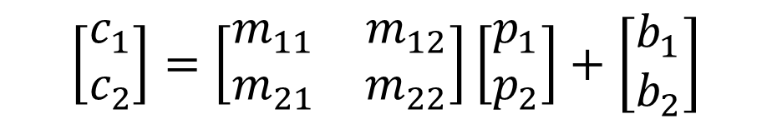
The Affine Diagraph Cipher
This is the equation for the affine diagraph cipher. Where c­ denotes the enciphered text coefficients, m denotes the encoding matrix coefficients, p denotes the plain text coefficients, and b denotes the coefficients on the enciphering vector.
$$\left[\begin{aligned}&c_{1} \\ &c_{2}\end{aligned}\right]=\left[\begin{matrix}m_{11} & m_{12} \\ m_{21} & m_{22}\end{matrix}\right]\left[\begin{aligned}&p_{1} \\ &p_{2}\end{aligned}\right]+\left[\begin{aligned}&b_{1} \\ &b_{2}\end{aligned}\right]$$

Slide 7
The Affine Diagraph Cipher Explained
The affine diagraph cipher is a more complex variant of the affine cipher. This cipher takes pairs of letters (p₁ ,p₂), puts them into a 2x1 vector, then multiplies them by a 2x2 enciphering matrix, and then adds it to a 2x1 enciphering vector (b₁,b₂). Remember we are working in modulo 26, this then returns a 2x1 vector that is the enciphered pair of letters (c₁,c₂).

Slide 8
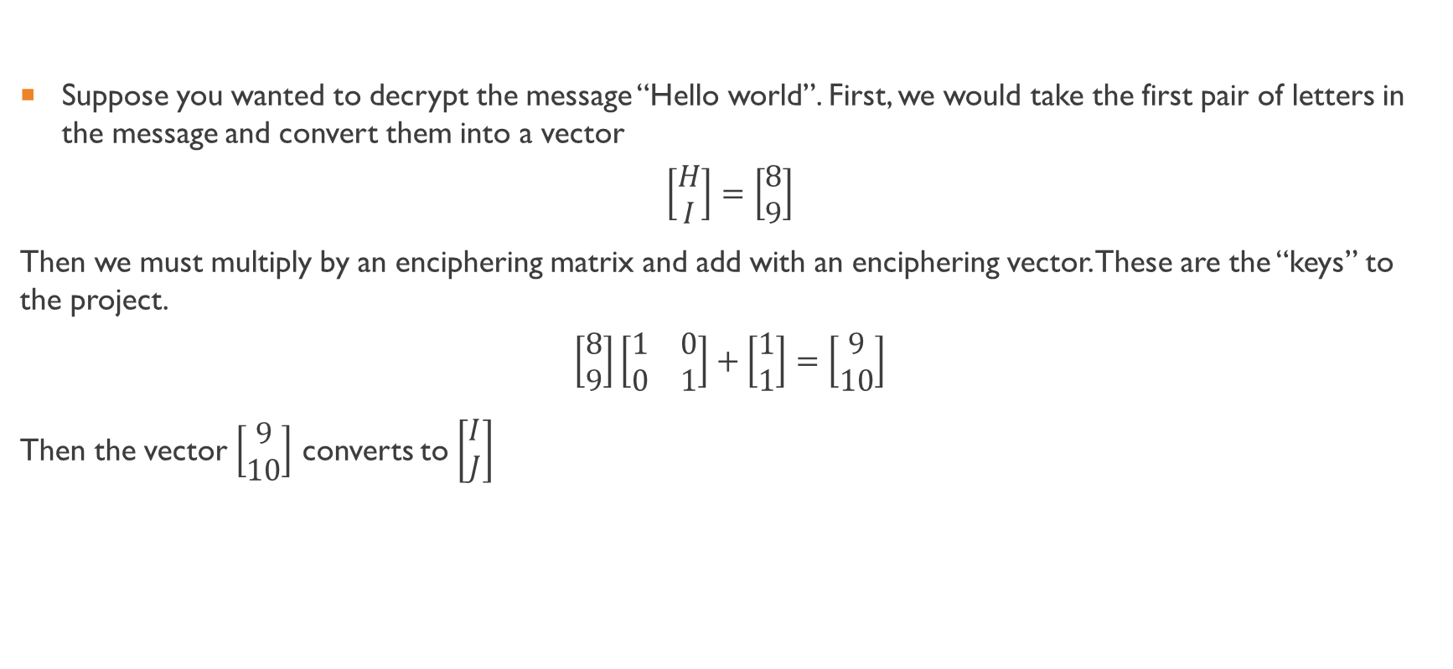
Example
Suppose you wanted to decrypt the message “Hello world”. First, we would take the first pair of letters in the message and convert them into a vector
$$\left[\begin{aligned}H \\ I\end{aligned}\right]=\left[\begin{aligned}8 \\ 9\end{aligned}\right]$$
Then we must multiply by an enciphering matrix and add with an enciphering vector. These are the “keys” to the project.
$$\left[\begin{aligned}8 \\ 9\end{aligned}\right]\left[\begin{matrix}1 & 0 \\ 0 & 1\end{matrix}\right]+\left[\begin{aligned}1 \\ 1\end{aligned}\right]=\left[\begin{aligned}9 \\ 10\end{aligned}\right]$$
Then the vector $\left[\begin{aligned}9 \\ 10\end{aligned}\right]$ converts to $\left[\begin{aligned}I \\ J\end{aligned}\right]$

Slide 9

Algorithm to Find the Keys

Slide 10
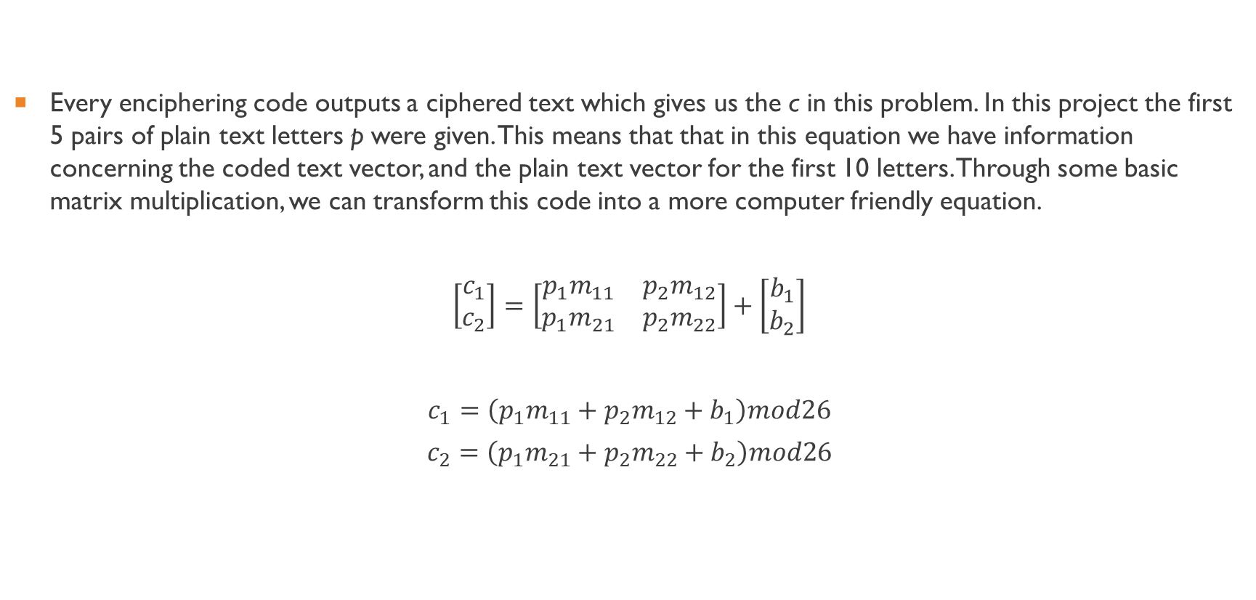
Rewriting the Affine Diagraph Cipher
Every enciphering code outputs a ciphered text which gives us the c in this problem. In this project the first 5 pairs of plain text letters p were given. This means that that in this equation we have information concerning the coded text vector, and the plain text vector for the first 10 letters. Through some basic matrix multiplication, we can transform this code into a more computer friendly equation.
$$\left[\begin{aligned}c_{1} \\ c_{2}\end{aligned}\right]=\left[\begin{matrix}{p_{1}m}_{11} & p_{2}m_{12} \\ p_{1}m_{21} & {p_{2}m}_{22}\end{matrix}\right]+\left[\begin{aligned}b_{1} \\ b_{2}\end{aligned}\right]$$
$$c_{1}=\left(p_{1}m_{11}+p_{2}m_{12}+b_{1}\right)mod26$$
$$c_{2}=\left(p_{1}m_{21}+p_{2}m_{22}+b_{2}\right)mod26$$

Slide 11
Rewriting the Affine Diagraph Cipher
This equation is much easier to input to a computer program, since it does not require the program to know linear algebra. This leaves us only to discover what the coefficients on the encoding matrix are, and what are the coefficients on the encoding vector. Since we are working in modulo 26, the only possible entries for any numbers used in this equation are 0 through 25. This narrows the possibilities for each entry to 26. Also, there is something very important to note here. Notice the equation for c₁ does not depend on m₁₁, m₁₂, and b₁ , and c₂ does not depend on m₂₁,m₂₂, and b₂ for now (this will come up later). We can then find solutions for the equations for c₁ and c₂ independently. This is very important as if we had to put these all into a nested for-loop the program will take forever to load.

Slide 12
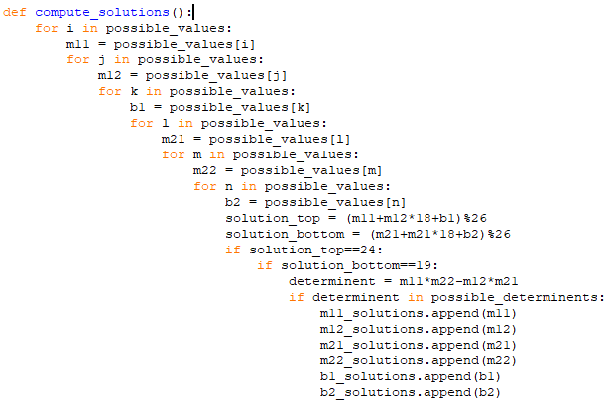
Wrongly Decrypting the Affine Diagraph Cipher

Slide 13
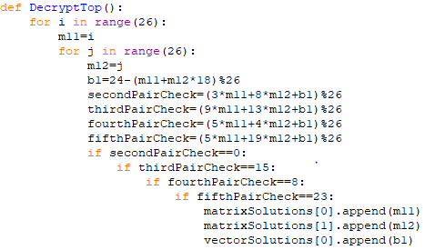
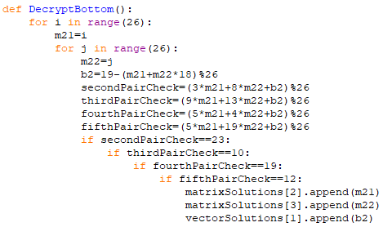
A Better Decryption

Slide 14
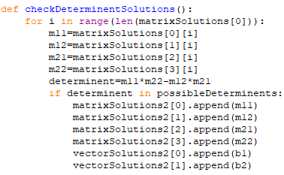
Determinant Check

Slide 15
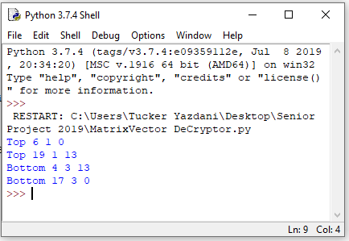

Running the program

Slide 16
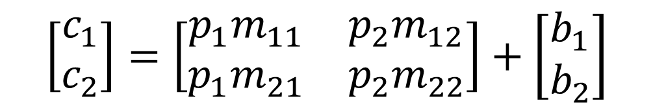

Solutions for the Key
$$\left[\begin{aligned}c_{1} \\ c_{2}\end{aligned}\right]=\left[\begin{matrix}{p_{1}m}_{11} & p_{2}m_{12} \\ p_{1}m_{21} & {p_{2}m}_{22}\end{matrix}\right]+\left[\begin{aligned}b_{1} \\ b_{2}\end{aligned}\right]$$
$$M=\left[\begin{matrix}6 & 1 \\ 17 & 3\end{matrix}\right] b=\left[\begin{aligned}&0 \\ &0\end{aligned}\right]$$

Slide 17
Algorithm to Decrypt the Message

Slide 18
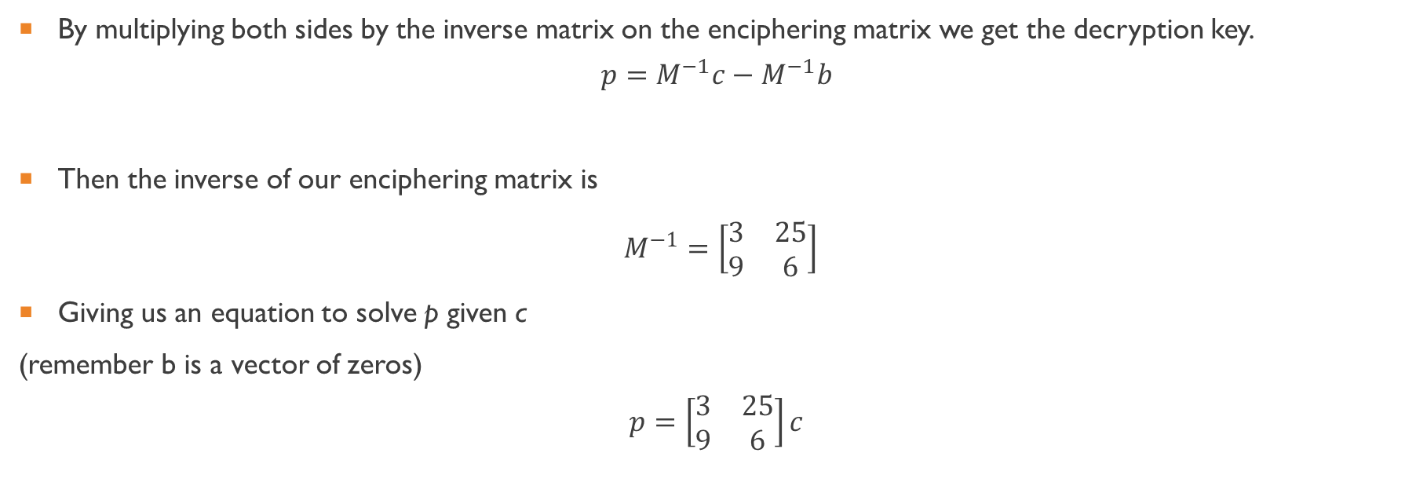
Decryption Key
By multiplying both sides by the inverse matrix on the enciphering matrix we get the decryption key.
$$p=M^{−1}c−M^{−1}b$$
Then the inverse of our enciphering matrix is
$M^{−1}=\left[\begin{matrix}3 & 25 \\ 9 & 6\end{matrix}\right]$
Giving us an equation to solve p given c
(remember b is a vector of zeros)
$$p=\left[\begin{matrix}3 & 25 \\ 9 & 6\end{matrix}\right]c$$

Slide 19
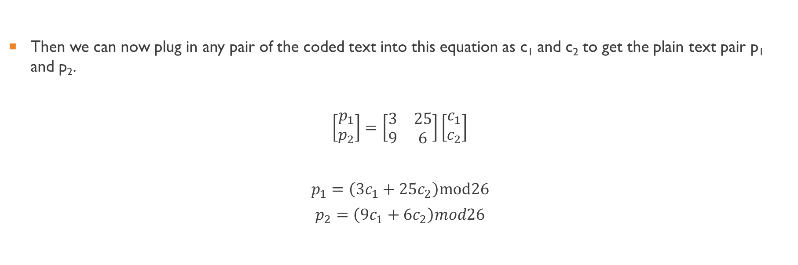
Decryption Key
Then we can now plug in any pair of the coded text into this equation as c₁ and c₂ to get the plain text pair p₁ and p₂.
$$\left[\begin{aligned}p_{1} \\ p_{2}\end{aligned}\right]=\left[\begin{matrix}3 & 25 \\ 9 & 6\end{matrix}\right]\left[\begin{aligned}c_{1} \\ c_{2}\end{aligned}\right]$$
$$p_{1}=\left(3c_{1}+25c_{2}\right)mod26$$
$$p_{2}=\left(9c_{1}+6c_{2}\right)mod26$$

Slide 20
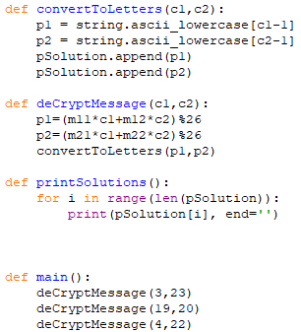
Algorithm to Decrypt the Message

Slide 21
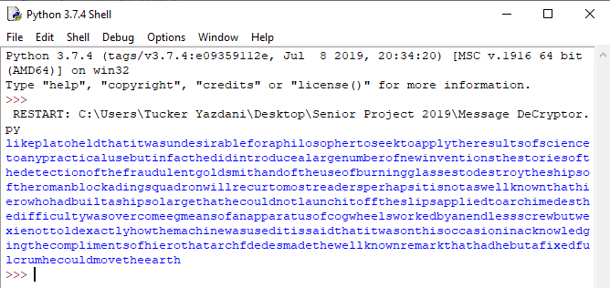
Running the Message Decryption Program

Slide 22
Decoded Message
“Archimedes like Plato held that it was undesirable for a philosopher to seek the results of science to any practical use but in fact he did introduce a large number of inventions. The stories of the detection of the fraudulent gold smith and of the use of burning lasses to destroy the ships of the roman blockading squadron will recur to most readers. Perhaps it is not as well known that Hiero who had built ships so large that he could not launch it off the slips applied to Archimedes the difficulty was overcome by means of an apparatus of cog wheels worked by an endless screw, but we are not told exactly how the machine was used it is said that it was on this occasion in acknowledging the compliments of Hiero that Archimedes made the well known remark that had he but a fixed fulcrum could move the earth.”

Slide 23

Thank you for your time

